Slide 1

America's overview of superconducting science and technology of ingot niobium
Gianluigi Ciovati
Symposium on the Superconducting Science and Technology of Ingot Niobium
September 22-24, 2010
Thomas Jefferson National Accelerator Facility

Slide 2
Outline
Single-cell cavities performance
Multi-cell cavities performance
Samples material studies
“Optimized” treatment process for SRF cavity

Slide 3
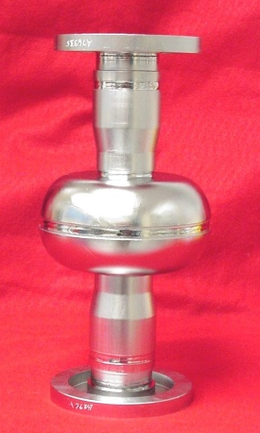
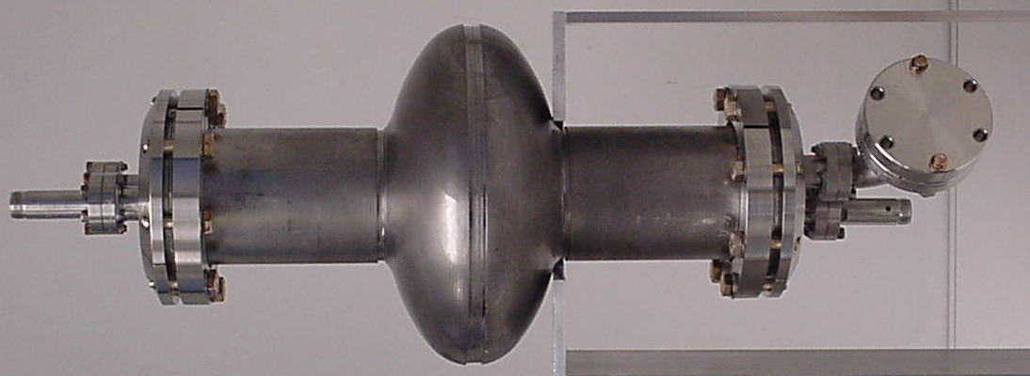
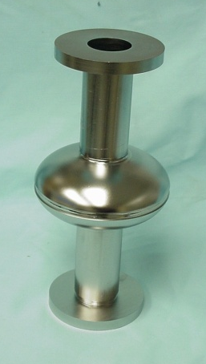
Performance of Single-Cell Cavities
Summary of large grain/single crystal single cell tests as of 2006
18 Single-cells made from Nb sheets from CBMM, Wah Chang, Heraeus and Ningxia
RRR between ∼ 280 ÷ 500
Avg. peak surface magnetic field at quench (B_{p,quench}): 140 ± 14 mT
P. Kneisel et al., Proc. of the International Niobium Workshop, Oct. 30-Nov. 1st, Araxá, Brasil, 2006, p. 84

Slide 4
Reproducible Performance
1300 MHz TESLA-type single-cell cavities from different Nb suppliers, after post-purification at 1250 °C/3 h with Ti, 50 μm BCP, HPR, 120 °C/12 h baking:
P. Kneisel et al., Proc. of the International Niobium Workshop, Oct. 30-Nov. 1st, Araxá, Brasil, 2006, p.84

Slide 5
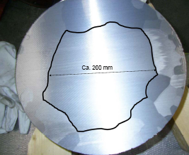
Increase Statistic on Single-Cell Performance
5 single-cell 1300 MHz cavities each built from CBMM, Heraeus and Ningxia Nb sheets
Same surface treatment:
  25-50 μm BCP, 600 °C/10 h heat treatment, 50-90 μm BCP, HPR, 120 °C/12 h baking
CBMM
Heraeus
Ningxia
5 TESLA
5 ILC_LL
5 TESLA
P. Kneisel, Proc. 13th SRF Workshop, Oct. 14-19 2007, Bejing, China, p. 728

Slide 6



RF Test Results
Test results so far
Ningxia: B_{p,quench} = 141 ± 18 mT
Heraeus: B_{p,quench} = 147 ± 19 mT
…consistent with initial results.
Images of equator region of Heraeus single-cell, 0.5” from weld

Slide 7
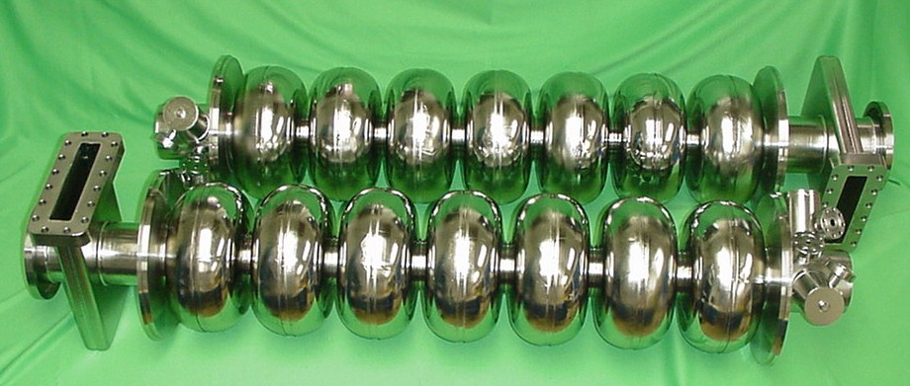
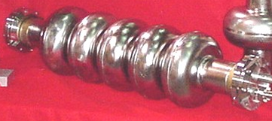
Multi-cell Cavities
J100-1 and J100-2, 7-cell, Low Loss shape, 1497 MHz
High Current, 5-cell, 1497 MHz
ILC-LowLoss, 7-cell, 1300 MHz

Slide 8
Fabrication & Treatment
Cavities were built mostly from CBMM Ingots A, B, C, D. The RRR of the ingots is ∼ 280 but different Ta content:
Almost every cavity had a hole blown during EBW of one of the equator’s cells which had to be repaired
“Standard” treatment: ∼ 50 μm BCP, 600 °C/10 h heat treatment, ∼ 50 μm BCP, HPR. Some cavities required further treatments such as post-purification with Ti at 1250 °C/3 h
Ingot | Ta content (wppm)
A | 800
B | 800
C | 1500
D | 1300

Slide 9
Test Results: 1300 MHz cavities
T = 2.0 K
Corresponding accelerating gradient between 21 – 31 MV/m

Slide 10
Test Results: 1497 MHz cavities
T = 2.0 K
Corresponding accelerating gradient between 16 – 28 MV/m

Slide 11
Summary of Test Results
Average B_{p,quench}= 100 ± 18 mT
Problem with EBW was the main limitation to achieve higher gradients. “Grooves” and “pits” sometimes observed in the inner surfaces
Q₀(B_{p}) relatively “flat” up to B_{p} ∼ 90 mT
Residual resistance is lower than fine-grain Nb:
G. Ciovati et al., Appl. Supercond. Conf., Aug. 1-6, 2010, Washington DC, to be published

Slide 12
“Anomalous” Losses in LG Cavities
The LG multi-cell cavities with lowest performance were built from CBMM Ingot B. Other single-cells built from this Ingot performed well (B_{p,quench}= 112 - 143 mT)
HC 5-cell, 1497 MHz, Ingot B
T = 2.0 K

Slide 13
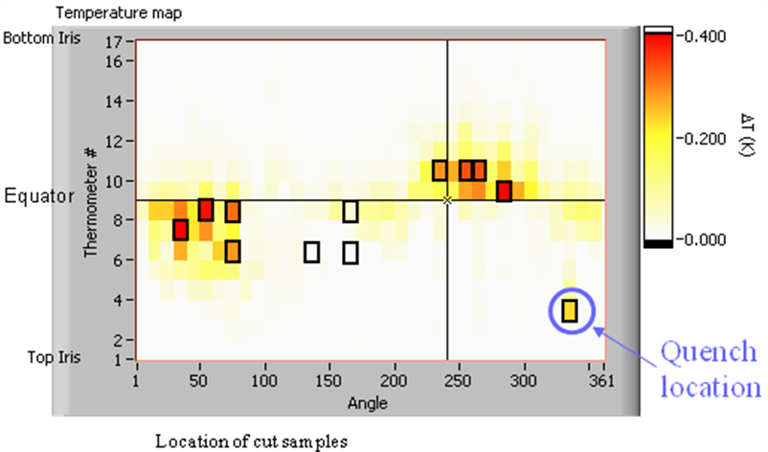
Study of Losses on LG Single-Cell
A 1497 MHz single-cell built from CBMM Ingot B showed similar behavior observed in the multi-cell cavities built from this Ingot
Temperature map at 90 mT
9
10
11
4
5
8
3
12
1
6
7
2
T = 1.7 K
Heating in large areas at the equator observed after progressive material removal by BCP 1:1:1, starting at low field

Slide 14
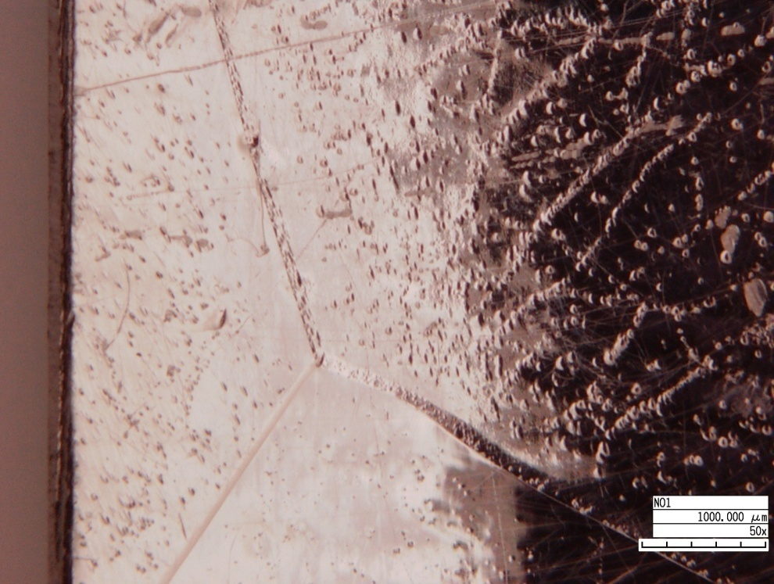
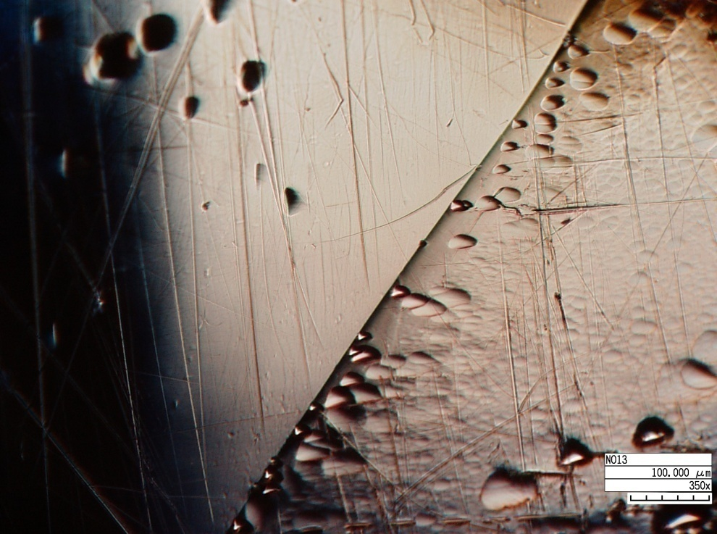
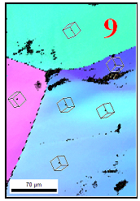
Studies on Cut Samples
“Pits” were found with higher density in “hot-spot” samples than “cold” samples (Hi-res. optical microscope)
The size of the pits (3D profilometer) ranged between 20-80 µm in width and 2-10 µm in depth
Different crystal orientation shows different pitting
Preliminary data do not show clear correlation between crystal orientation and RF losses (EBSD)
Optical microscopy images of “hot-spot” sample No. 9
Crystal orientation map of sample No. 9
X. Zhao et al., Proc. 14th SRF Conference, Sep. 20-25, 2009, Berlin, Germany, p. 446

Slide 15

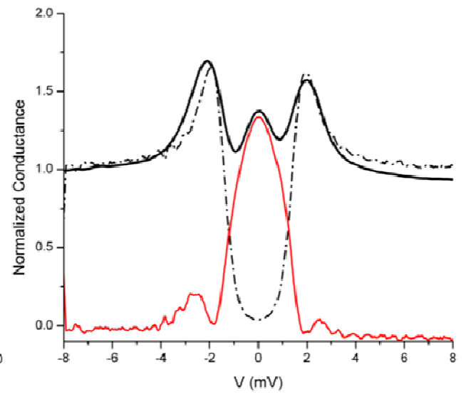
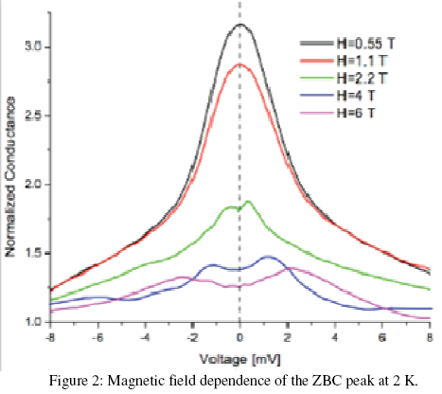
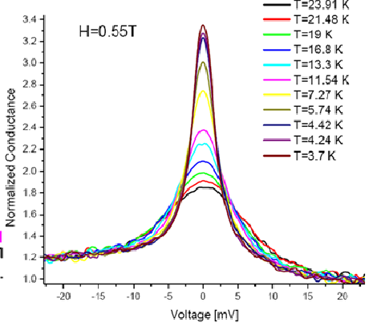
Studies on Cut Samples
“Hot-spot” samples show high values of zero-bias conductance (ZBC) in Point Contact Tunneling measurements
T=1.6 K
H = 0
The ZBC peak is related to the presence of localized magnetic moments (Appelbaum-Anderson theory) within the tunnel oxides or near the interface with Nb
T. Prolier et al., Proc. 14th SRF Conference, Sep. 20-25, 2009, Berlin, Germany, p. 137

Slide 16

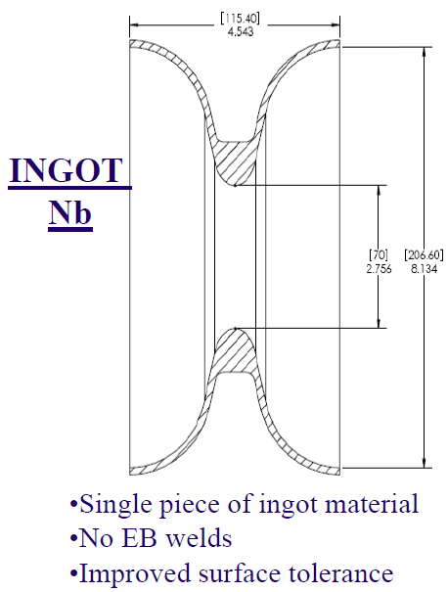
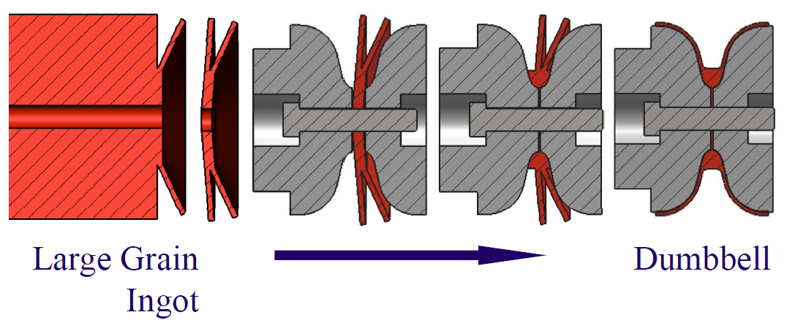
More Options for Cavity Fabrication
Use industrial metal working processes to fabricate SRF cavity
assemblies directly from large grain/ingot
T. Grimm, 6th SRF Materials Workshop, FSU, Feb. 18-20, 2010

Slide 17
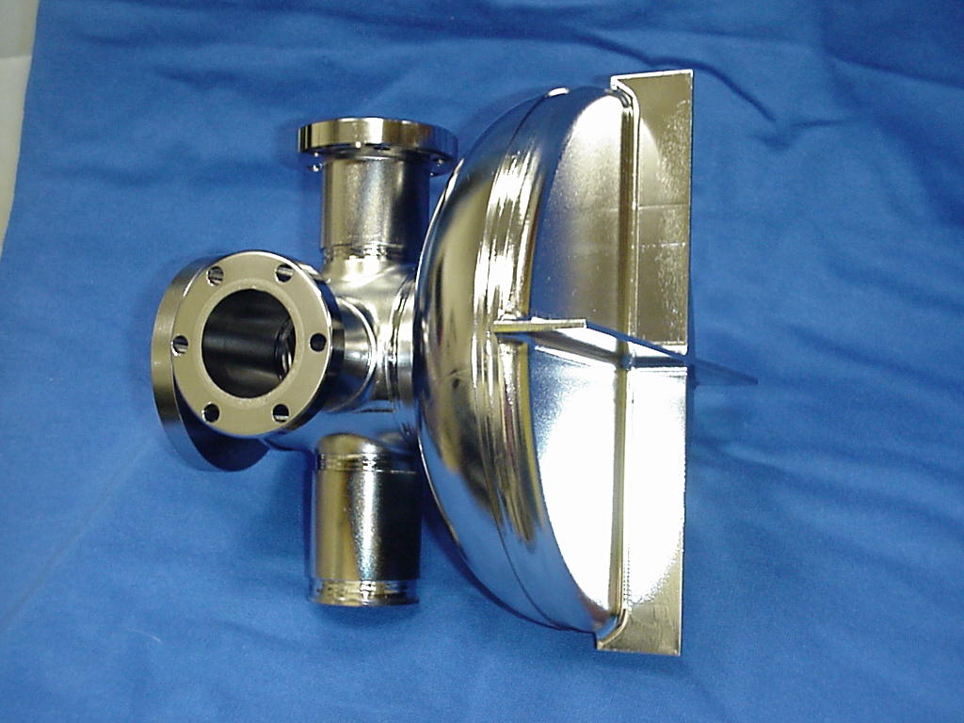
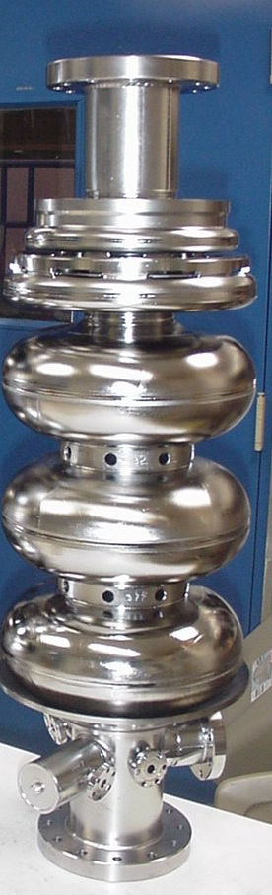
More Options for Cavity Fabrication
Half-cell 1.3 GHz cavity for laser heating of Nb experiment
Cavity parts machined from Ingot blocks
3.5-cell 1.3 GHz Rossendorf photo-injector cavity

Slide 18
Material Studies

Slide 19
Superconducting properties of Ingot Nb
4 cylindrical samples (∅ 6 mm, 120 mm long) machined from CBMM new Ingot series A, B, C, D
Measure thermal conductivity, critical temperature, near-surface critical fields, DC critical fields after:
  180 μm BCP 1:1:1, 600 °C/10 h, 24 μm BCP 1:1:2
  Baking at 120 °C – 160 °C for 12 h
  50 μm EP
  Baking at 120 °C/12 h
See talk by A. Dhavale tomorrow at 8:30 am

Slide 20
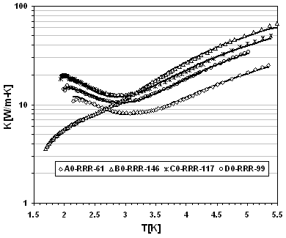
Superconducting properties of Ingot Nb
Sample C, T=2K
Thermal conductivity after 180 μm BCP 1:1:1
RRR changes by a factor > 2 but
  bulk H_{c1} < 10% variation after BCP, surface H_{c1} < 20% variation
Surface H_{c1} increases after baking up to ∼ 130 mT, independent of RRR
Changes in hysteresis between surface H_{c1} and H_{c2} and skin depth after baking
B_{c1}(2 K) after 180 μm BCP 1:1:1 and after baking
J. Mondal et al., Proc. 14th SRF Conference, Sep. 20-25, 2009, Berlin, Germany, p. 455 and to be published

Slide 21
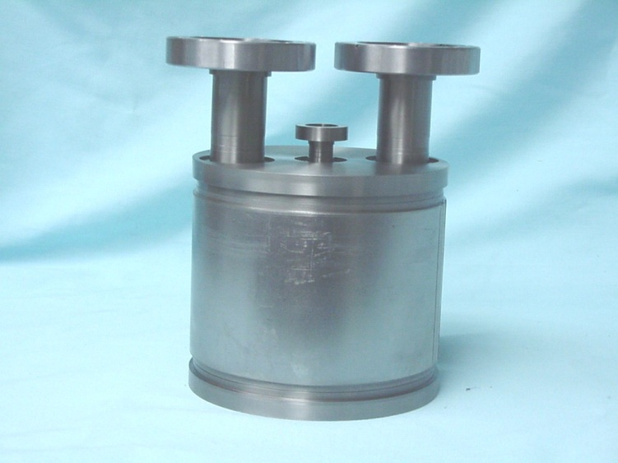
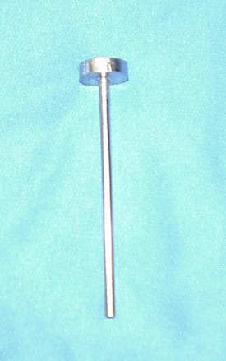
Superconducting properties of Ingot Nb
We’d like to measure the behavior of the samples at high RF fields (∼ 100 mT) by inserting it in a “pill-box” cavity
Sample port
Excite TE₀₁₁ mode at 3.5 GHz
Issues with multipacting
Issues with heat flux through cooling channel
Larger ∅ samples have been made, to be tested
2 single-cell cavities made from the new Ingot A and B had clusters of pits on the surface and strong RF losses

Slide 22



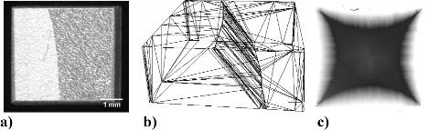

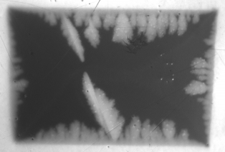
Study of Fluxoids at Grain Boundaries
Magneto-optical imaging: flux penetration at grain boundaries (GB) is highly sensitive to the orientation of the GB plane wrt the applied magnetic field
See talk by A. Polyanskii tomorrow at 2:30 pm
GB#2
DC transport studies to measure the dynamic of fluxoids at grain boundaries
See talk by Z. H. Sung tomorrow at 9:30 am
P. J. Lee et al., Proc. of the International Niobium Workshop, Oct. 30-Nov. 1st, Araxá, Brasil, 2006, p. 113
Z. H. Sung et al., Appl. Supercond. Conf., Aug. 1-6, 2010, Washington DC, to be published

Slide 23


Metallurgical and Heat Transfer Studies
Metallurgical studies of large-grain/single-crystal Nb samples:
  Dependence of mechanical properties on crystal orientation
  Studies on recovery and recrystallization after heat treatments
  Crystallographic studies of EBW samples
Thermal conductivity studies of large-grain/single-crystal Nb samples and its dependence on the metallurgical state
See talk by T. Bieler today at 2:30 pm
See talk by S. Chandrasekaran tomorrow at 9:00 am
T. Bieler et al., Phys. Rev. ST Accel. Beams 13, 031002 (2010)

Slide 24
Development of Optimized Process for SRF Cavities made of Large-Grain Nb
The road to a cost-effective production of SRF cavities with high-Q up to E_{acc} ∼ 25 MV/m

Slide 25
“Optimized” Process
Cavity fabrication
∼ 80 μm material removal by CBP
∼ 20 μm material removal by BCP
Heat treatment at 800 °C/3 h + 120 °C/12 h
Surface passivation with thin nitride layer
High-Pressure Rinse
Uniformely smooth surface. Fully developed at KEK
Remove hydrogen and stress relief. 25%-80% improvement of Q₀(2 K, 100 mT) at JLab
Reduce hydrogen re-absorption and oxidation
T. Higuchi et al., Proc. of the 10th SRF Workshop, Tsukuba, 2001, p. 431.
G. Ciovati et al., Phys. Rev. ST Accel. Beams 13, 022002 (2010)
G. Myneni, B. Hjorvasson, G. Ciovati, US Patent 7,151,347 B1, Dec. 19, 2006

Slide 26
Heat Treatment Temperature Study on Single-Cell
“Ningxia” LG Nb, 1470 MHz
Largest improvement of Q₀ after 800 °C heat treatment
Reduction of quench field above 800 °C (furnace contamination?)

Slide 27

Analysis of Samples Treated with Cavity
SIMS analysis of heat-treated samples:
  Comparison with fine-grain samples
  Comparison with reference sample (no heat treament)
800C/3h, 120C/12h
BCP, no HT
Quantitative depth profiling of H in samples
See talk by P. Maheswari tomorrow at 10:30 am

Slide 28
Summary and Conclusions
Since it’s “invention” (or “re-discover”) in 2005, SRF single-cell cavities made of large-grain, ingot Nb built in the USA have demonstrated the achievement of B_{p} ∼ 140 mT (E_{acc} ∼ 32 MV/m) reproducibly, using BCP treatment.
∼ 40% lower R_{res} (higher Q₀) than fine-grain Nb has also been achieved reproducibly.
Need more data on RF performance of SRF cavities made of ingots with RRR < ∼200 for further cost reduction.
Problems with EBW of large-grain multi-cell cavities at JLab need to be understood and solved.
Strong RF losses in cavities built from some ingots have been observed and associated to pitting and regions with high concentrations of magnetic impurities.

Slide 29
Summary and Conclusions
Metallurgical and superconductivity studies on large-grain Nb samples gave better understanding on formability issues, lattice defects and how they relate to properties such as flux penetration, heat conduction, surface critical fields.
Alternative fabrication methods of cavity parts may apply to further reduce cost.
A process for improved SRF cavity performance (pushing to higher Q) is being developed based on heat treatment and passivation.

Slide 30
Acknowledgments
P. Kneisel, G. Myneni, X. Zhao (JLAB)
F. Stevie, P. Maheswari (NCSU)
T. Bieler (MSU)
J. Mondal (BARC)
P. Lee, A. Polyanskii (FSU)
T. Grimm (Niowave)

